Slide 1
Large-scale Graph Mining with Spark
What I learned from mapping >15 million sites
Win Suen
PyGotham 2018

Slide 2
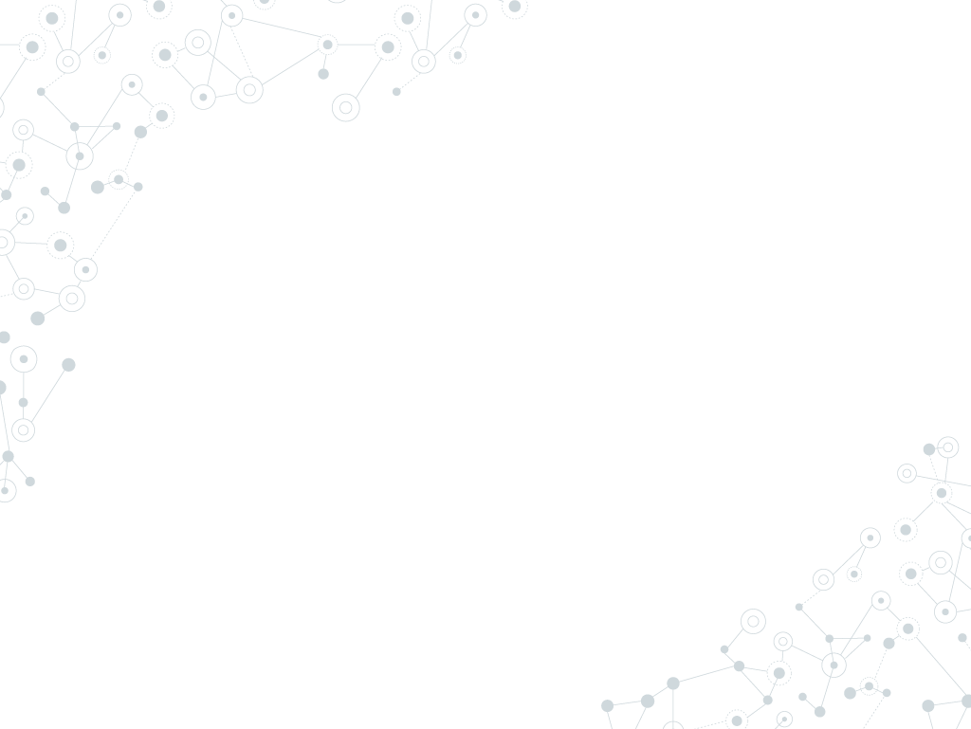
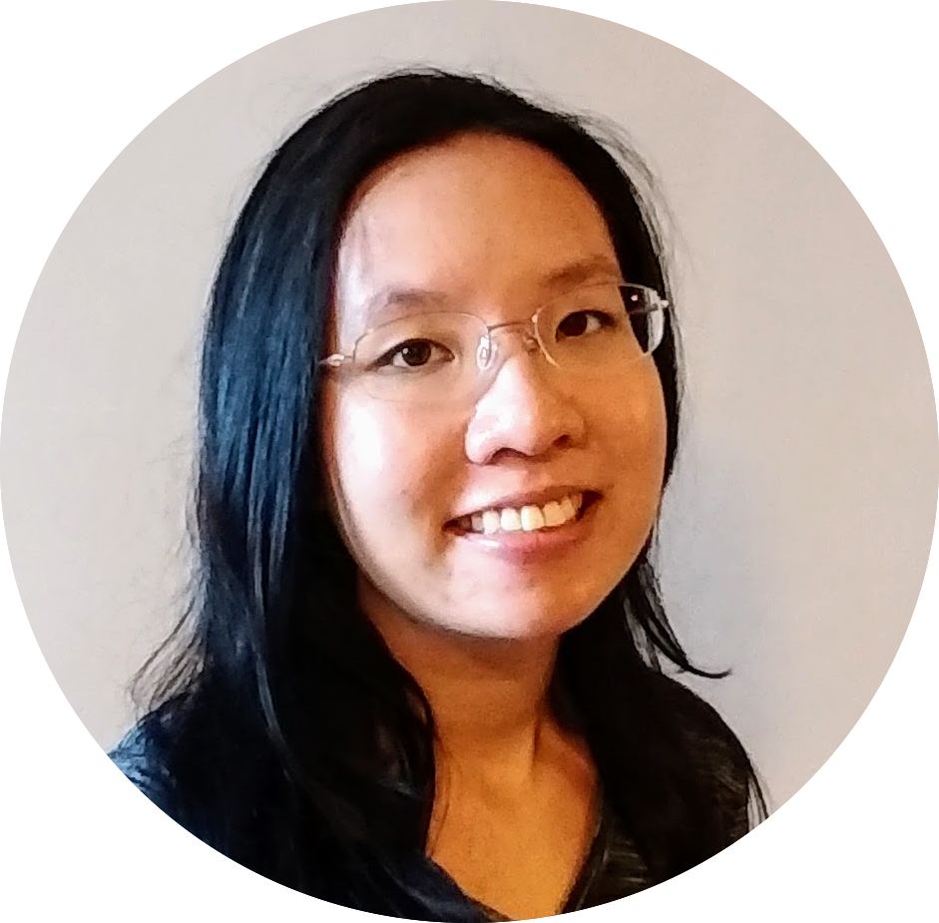
Hello!
I am Win Suen
Data Scientist @ AppNexus (now Xandr).
Avid hiker.
Reader of books and papers.

Slide 3
Agenda
Why?
Labelled data is not always available. Graphs can help.
How?
Find clusters from underlying graph structure, using community detection.
What?
Detect similar sites in large web graph.
Discussion

Slide 4
Graphs 101

Slide 5
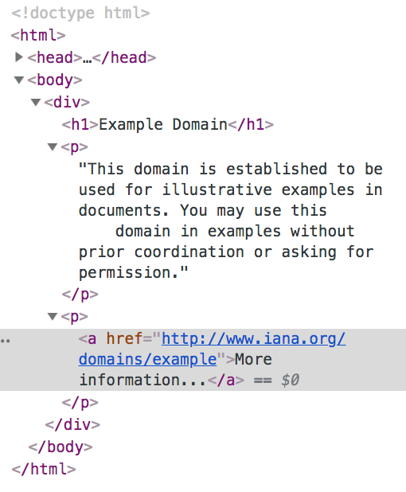
Web graphs
Node: example.com
Directed edge
Node: iana.org

Slide 6
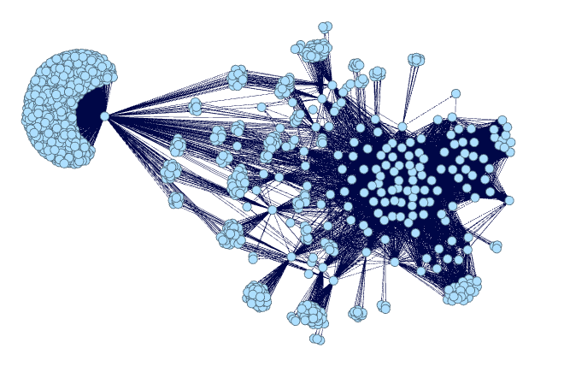
Web graphs: substructures
Subpage structure of a news site, generated by me using Gephi.

Slide 7
Applications of clustering
Predicting class labels with no previous data.
High-level groupings for audience segmentation, classification.
Recommender for similar sites.
Anomaly detection.
Part of semi-supervised ensemble.

Slide 8
1.
Why graphs?

Slide 9
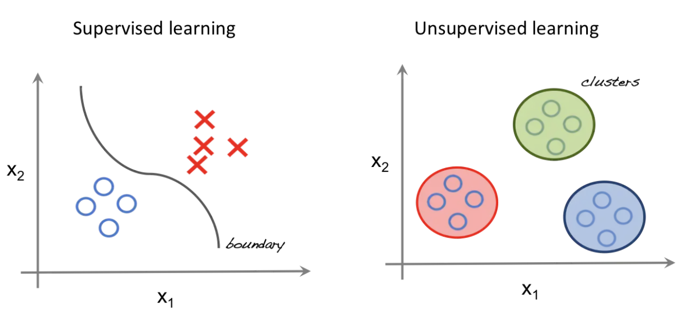
Look, ma! No labels!
http://beta.cambridgespark.com/courses/jpm/01-module.html

Slide 10
Why unsupervised learning?
Data isn’t free.
Labels not always available.
We may not know how many classes of things we are looking for.

Slide 11
How to do this with graphs? → Community detection!
Community
No single, precise definition.
Generally, substructure of a graph where nodes within structure are more densely connected to each other than nodes outside the substructure.
A community is like a cluster!

Slide 12
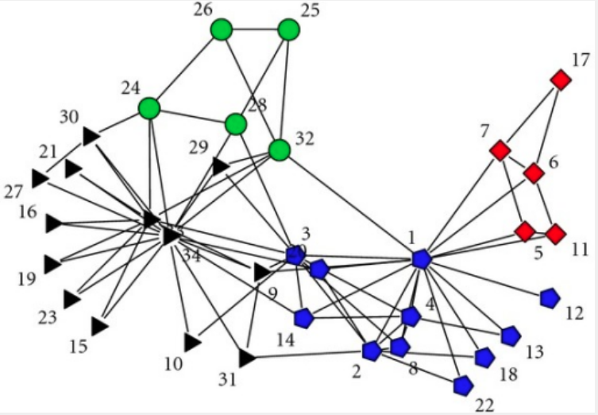
Communities
Zachary karate club dataset -- KONECT, April 2017.

Slide 13
Assumptions
Edges are correlated, not random!
Why?

Slide 14
Assumptions
Edges are correlated, not random!
Why?
Influence: “All my friends are doing it!”

Slide 15
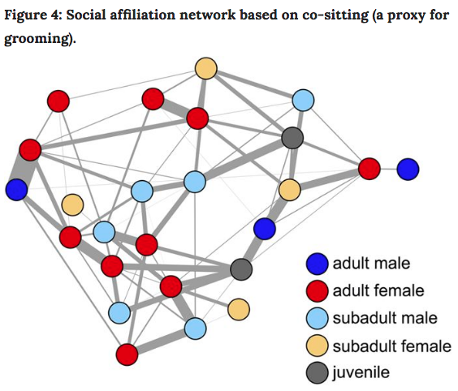
Influence
Farine, Damien R., et al. "Both nearest neighbours and long-term affiliates predict individual locations during collective movement in wild baboons." Scientific reports 6 (2016): 27704

Slide 16
Assumptions
Edges are correlated, not random!
Why?
Influence: “All my friends are doing it!”
Homophily: “Birds of a feather flock together” (aka assortative mixing).

Slide 17
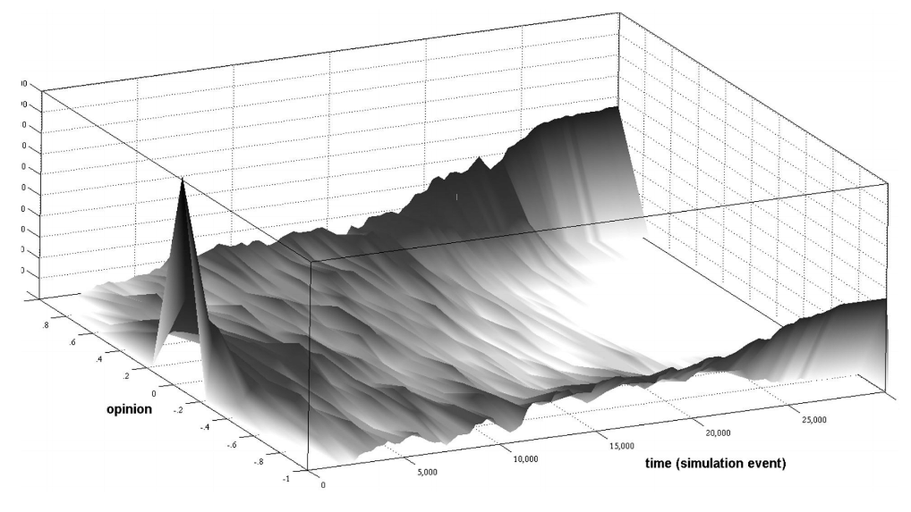
Homophily
Polarization over time
Garimella, Morales, et al, KDD’18.

Slide 18
2.
Community Detection

Slide 19
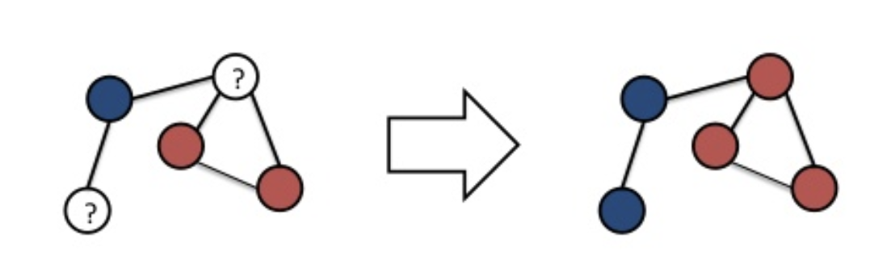
Label Propagation Algorithm (LPA)
Iterative approach. Labels “flow” through the graph.

Slide 20
LPA in action

Slide 21
Advantages of LPA
Labels not required.
External parameter setting (iterations) is nice, but not strictly necessary.
Runs in near linear time.
Interpretable results.
Raghavan, Usha Nandini, Réka Albert, and Soundar Kumara. "Near linear time algorithm to detect community structures in large-scale networks." Physical review E 76.3 (2007): 036106.

Slide 22
3. Code!

Slide 23
Why choose GraphFrames?
Processes data too large to fit on single machine.
Provides parallelism in processing.
Has some fault tolerance.
Integrates nicely with other python packages.

Slide 24
What I did
Clean Common Crawl dataset. Sample files, write custom parser for warc files, extract links from html.
Load graph into Graphframe.
Filter, clean, repeat. Do this, a lot.
Try to detect communities.

Slide 25
What I‘ll talk about
Clean Common Crawl dataset. Sample files, write custom parser for warc files, extract links from html.
Load graph into Graphframe.
Filter, clean, repeat. Do this, a lot.
Try to detect communities.

Slide 26
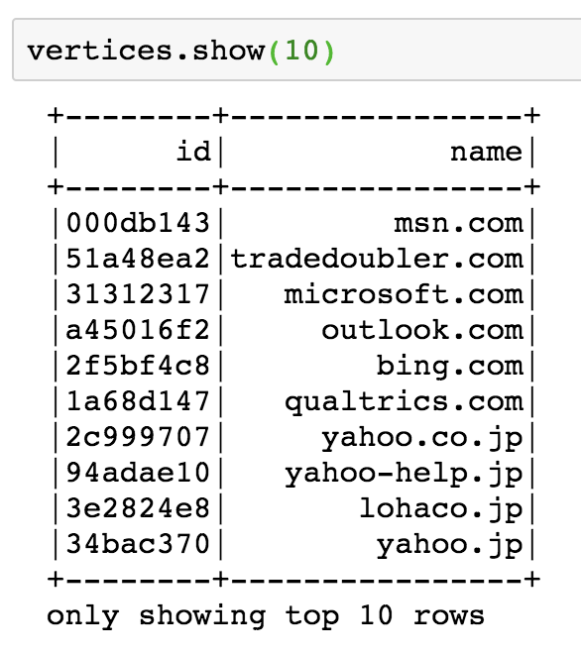
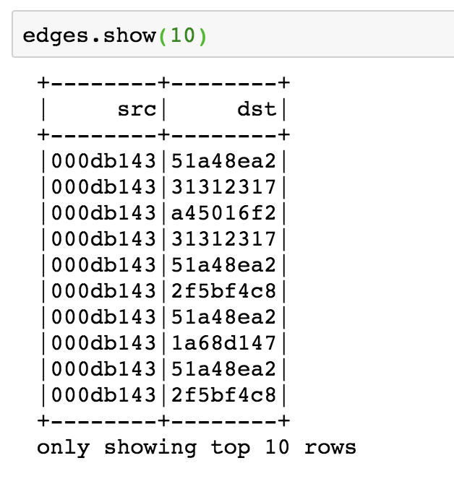
Create GraphFrame

Slide 27
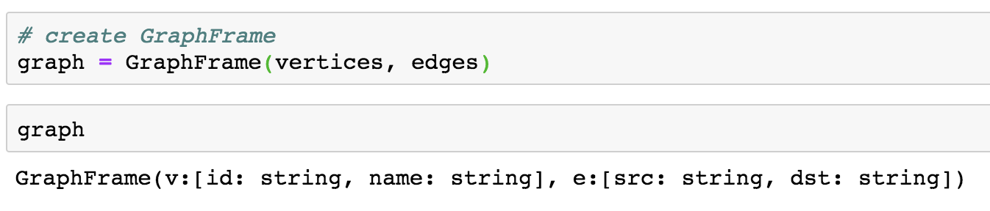
Create GraphFrame

Slide 28
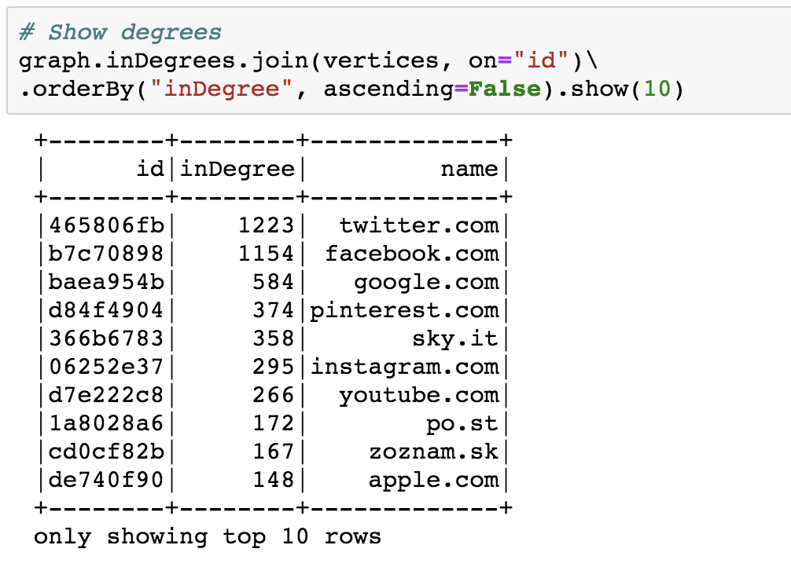
See top nodes

Slide 29
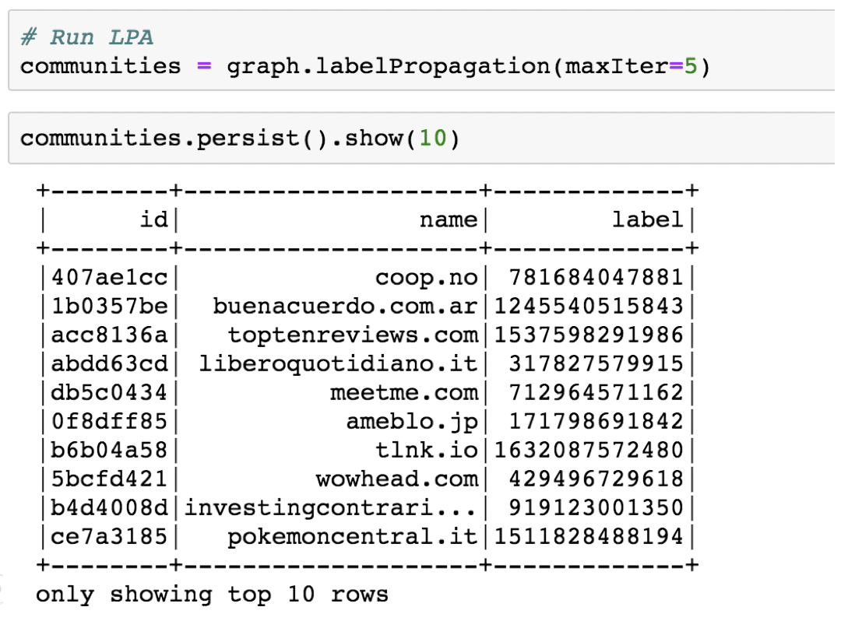
Run LPA

Slide 30
4. Results

Slide 31
> 15 million
4,782
3,573 sites
That’s a lot of nodes. Filter, clean, repeat.
Communities detected
Size of largest community

Slide 32
LPA converges around 5 iterations for sampled Common Crawl data.

Slide 33
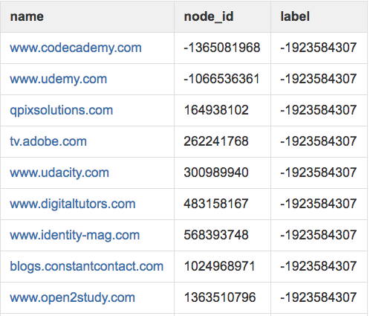
Community: online learning
Mixed community of online learning sites, sites that link to these sites.

Slide 34
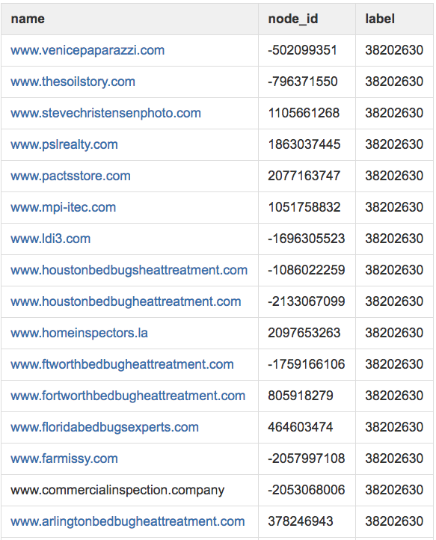
Community: bedbugs
Cookie cutter bedbug sites and sites with similar content resources.

Slide 35
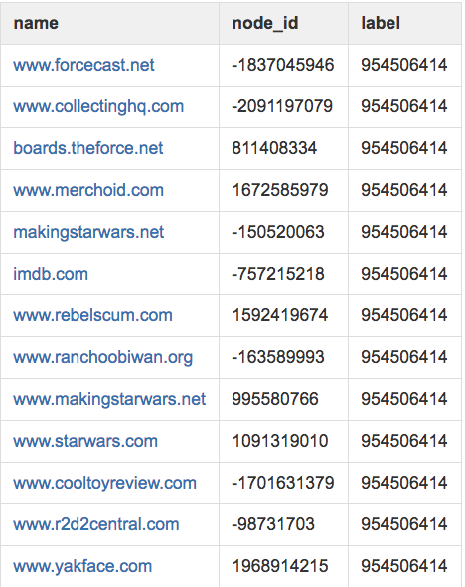
Community: fandoms
Sites related to Star Wars memorabilia.

Slide 36
We did this WITHOUT:
Human labelling.
Text processing, cleaning, feature extraction.
Domain name feature extraction.
We leveraged information in the underlying graph structure!

Slide 37
Future Research Ideas
Layer in edge attributes (link types, degree, external metadata, etc).
Monitor nodes of high centrality.
Observe how web graphs change over time.

Slide 38
Obligatory Summary Slide
Graphs very powerful for semi- and unsupervised problems.
Community detection: why and how it works.
Tools, results, applications.

Slide 39
The tip of the iceberg is what I talked about
Didn’t talk about:
Data parsing
Inconclusive results
Trials and many, many errors ☺
See my Medium post (forthcoming) for more gory detail.

Slide 40
Thanks!
Find me at:
wsuen13@gmail.com
Demo:
Tutorial:

